Slide 1

Chapter 3
Introduction
To
Physical
Layer
Copyright © The McGraw-Hill Companies, Inc. Permission required for reproduction or display.
Notes:
1

Slide 2
Chapter 3: Outline
3.1 DATA AND SIGNALS
3.2 PERIODIC ANALOG SIGNALS
3.3 DIGITAL SIGNALS
3.4 TRANSMISSION IMPAIRMENT
3.5 DATA RATE LIMITS
3.6 PERFORMANCE
Notes:
1.#

Slide 3

Chapter 3: Objective
The first section shows how data and signals can be either analog or digital. Analog refers to an entity that is continuous; digital refers to an entity that is discrete.
The second section shows that only periodic analog signals can be used in data communication. The section discusses simple and composite signals. The attributes of analog signals such as period, frequency, and phase are also explained.
The third section shows that only non-periodic digital signals can be used in data communication. The attributes of a digital signal such as bit rate and bit length are discussed. We also show how digital data can be sent using analog signals. Baseband and broadband transmission are also discussed in this section.
Notes:
1.#

Slide 4
Chapter 3: Objective (continued)
The fourth section is devoted to transmission impairment. The section shows how attenuation, distortion, and noise can impair a signal.
The fifth section discusses the data rate limit: how many bits per second we can send with the available channel. The data rates of noiseless and noisy channels are examined and compared.
The sixth section discusses the performance of data transmission. Several channel measurements are examined including bandwidth, throughput, latency, and jitter. Performance is an issue that is revisited in several future chapters.
Notes:
1.#

Slide 5
3-1 DATA AND SIGNALS
Figure 3.1 shows a scenario in which a scientist working in a research company, Sky Research, needs to order a book related to her research from an online bookseller, Scientific Books.
3.5
Notes:
1.#

Slide 6
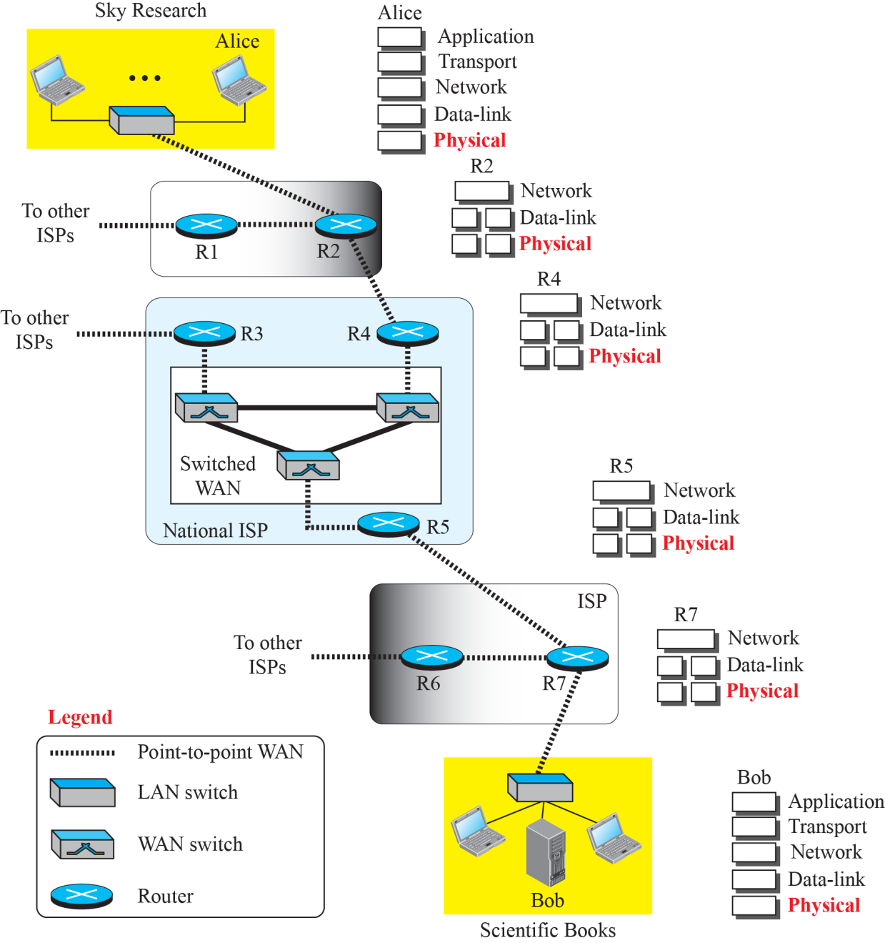
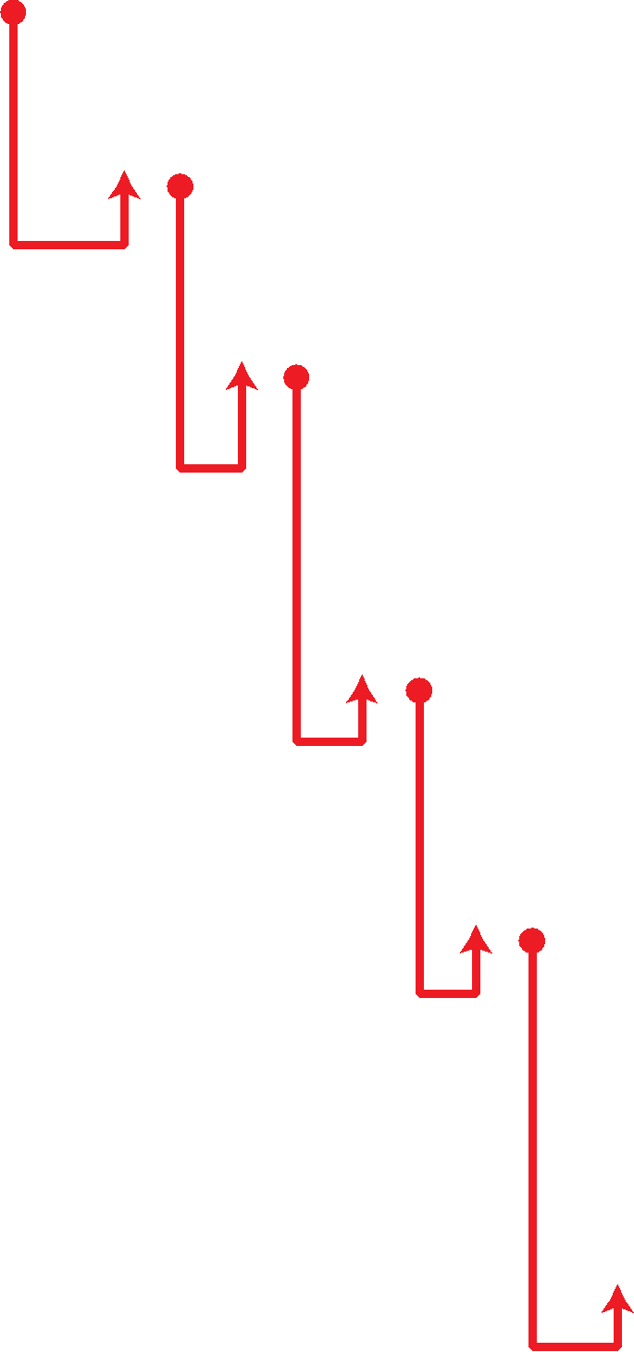
Figure 3.1: Communication at the physical layer
3.6
Notes:
1.#

Slide 7
3.1.1 Analog and Digital Data
Data can be analog or digital. The term analog data refers to information that is continuous; digital data refers to information that has discrete states. For example, an analog clock that has hour, minute, and second hands gives information in a continuous form; the movements of the hands are continuous. On the other hand, a digital clock that reports the hours and the minutes will change suddenly from 8:05 to 8:06.
3.7
Notes:
1.#

Slide 8
3.1.2 Analog and Digital Signals
Like the data they represent, signals can be either analog or digital. An analog signal has infinitely many levels of intensity over a period of time. As the wave moves from value A to value B, it passes through and includes an infinite number of values along its path. A digital signal, on the other hand, can have only a limited number of defined values. Although each value can be any number, it is often as simple as 1 and 0.
3.8
Notes:
1.#

Slide 9
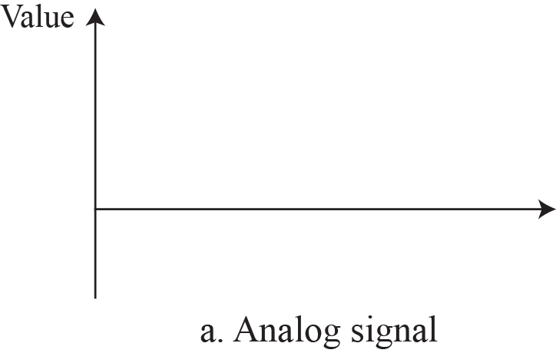

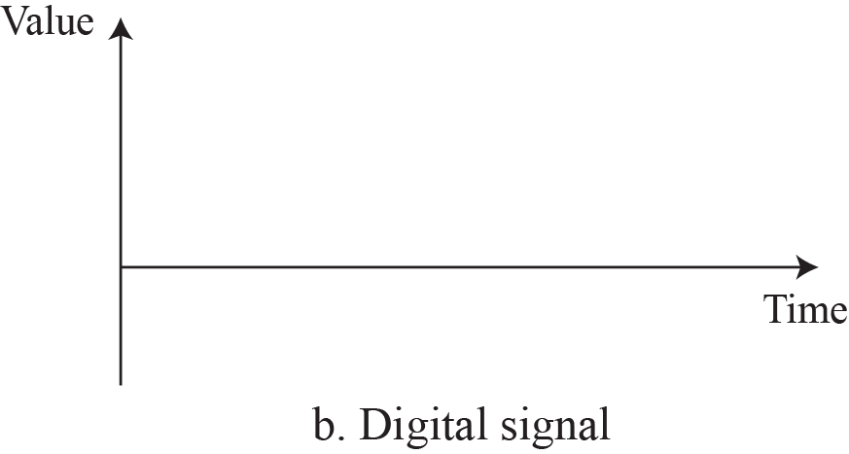

Figure 3.2: Comparison of analog and digital signals
3.9
Notes:
1.#

Slide 10
3.1.3 Periodic and Nonperiodic
A periodic signal completes a pattern within a measurable time frame, called a period, and repeats that pattern over subsequent identical periods. The completion of one full pattern is called a cycle. A nonperiodic signal changes without exhibiting a pattern or cycle that repeats over time. Both analog and digital signals.
3.10
Notes:
1.#

Slide 11
3-2 PERIODIC ANALOG SIGNALS
Periodic analog signals can be classified as simple or composite. A simple periodic analog signal, a sine wave, cannot be decomposed into simpler signals. A composite periodic analog signal is composed of multiple sine waves.
3.11
Notes:
1.#

Slide 12
3.2.1 Sine Wave
The sine wave is the most fundamental form of a periodic analog signal. When we visualize it as a simple oscillating curve, its change over the course of a cycle is smooth and consistent, a continuous, rolling flow. Figure 3.3 shows a sine wave. Each cycle consists of a single arc above the time axis followed by a single arc below it.
3.12
Notes:
1.#

Slide 13
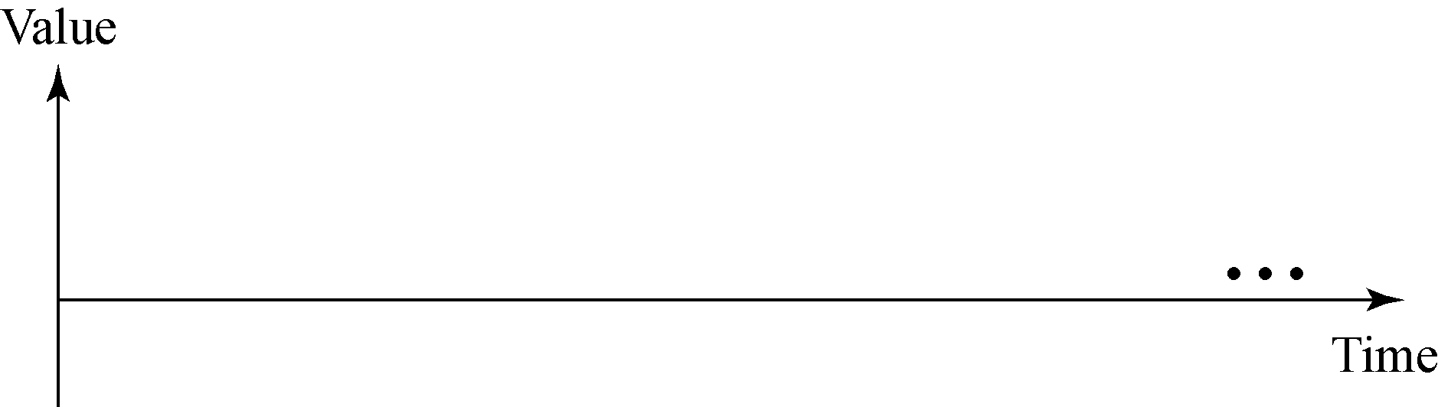

Figure 3.3: A sine wave
3.13
Notes:
1.#

Slide 14
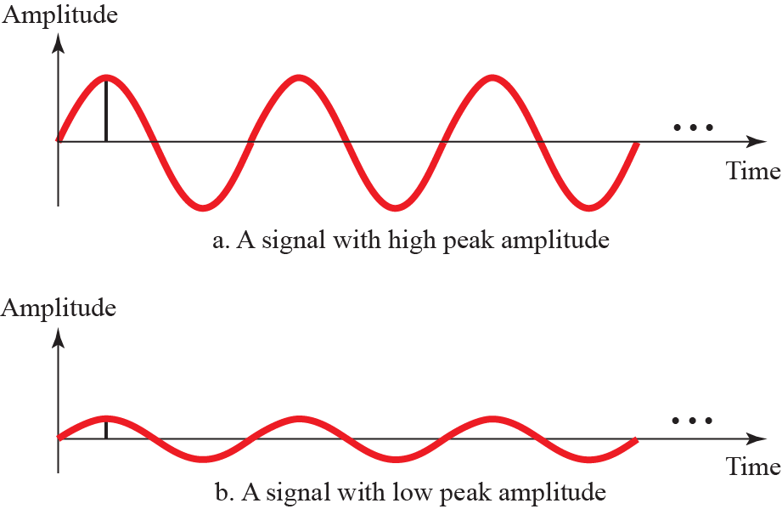
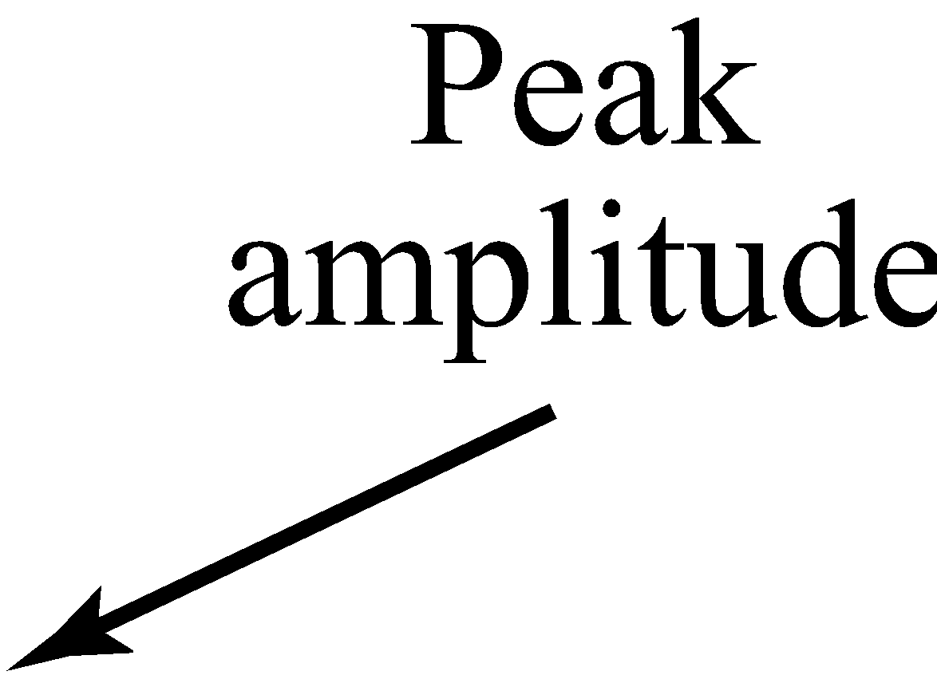
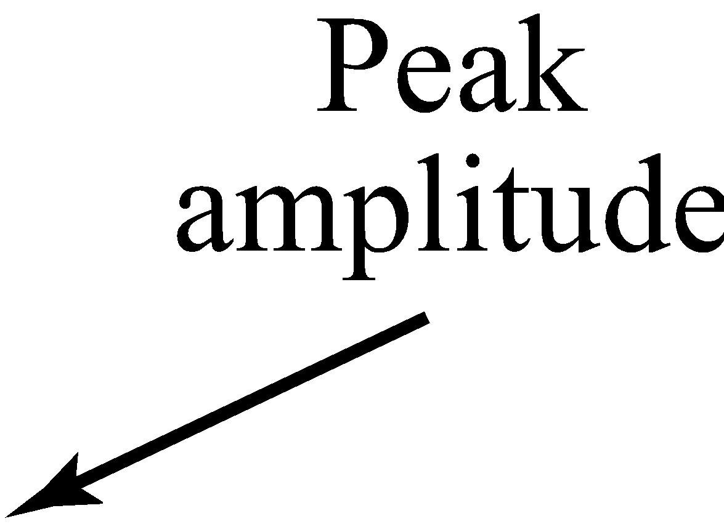
Figure 3.4: Two signals with two different amplitudes
3.14
Notes:
1.#

Slide 15
Example 3.1
The power in your house can be represented by a sine wave with a peak amplitude of 155 to 170 V. However, it is common knowledge that the voltage of the power in U.S. homes is 110 to 120 V. These are root mean square (rms) values. The signal is squared and then the average amplitude is calculated. The peak value is equal to 2^{1/2} × rms value.
3.15
Notes:
15

Slide 16
Example 3.2
The voltage of a battery is a constant; this constant value can be considered a sine wave, as we will see later. For example, the peak value of an AA battery is normally 1.5 V.
3.16
Notes:
16

Slide 17
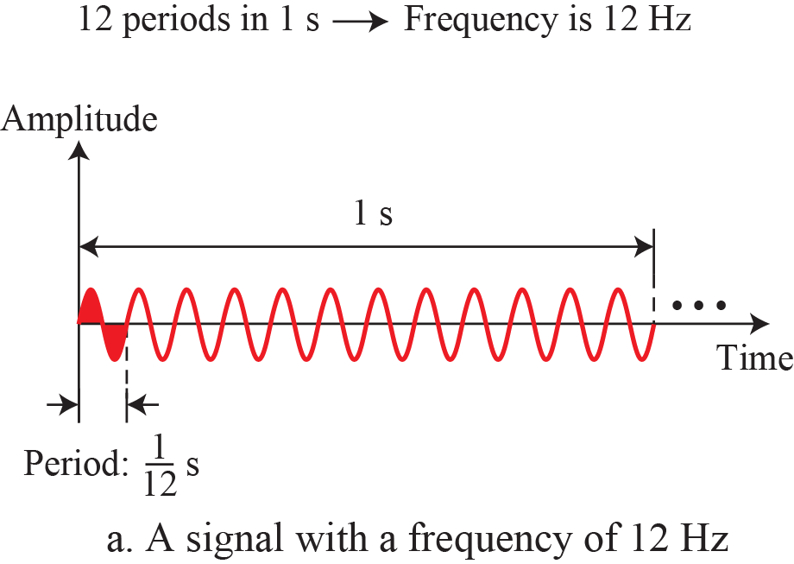
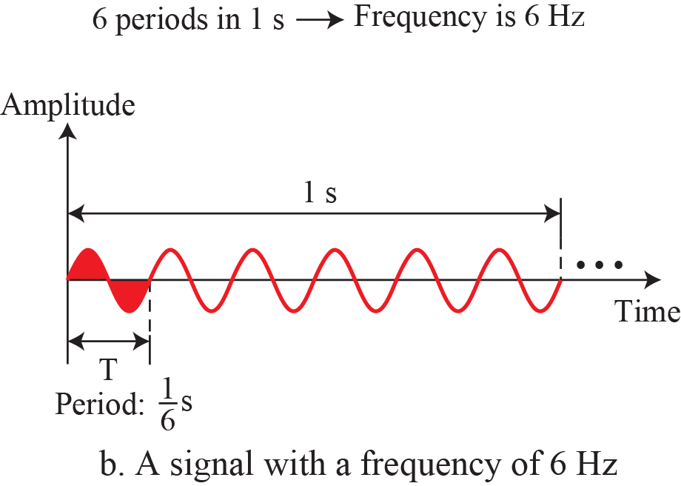
Figure 3.5: Two signals with the same phase and amplitude, but different frequencies
3.17
Notes:
1.#

Slide 18

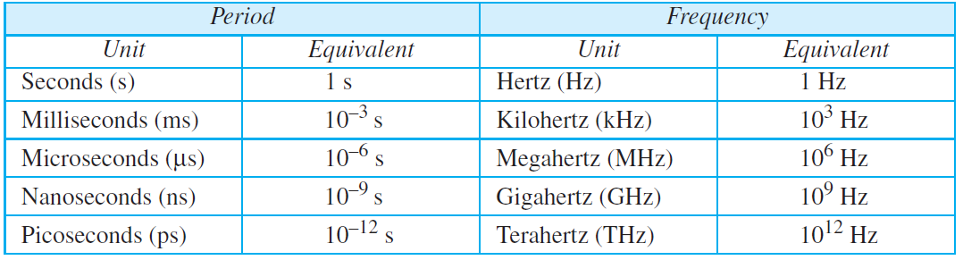
Table 3.1: Units of period and frequency
If we go down devide from that value that you want to find
If we go up multiply from that value that you want to find
3.18
Notes:
18

Slide 19
Example 3.4
Express a period of 100 ms in microseconds.
Solution
From Table 3.1 we find the equivalents of 1 ms (1 ms is 10⁻³ s) and 1 s (1 s is 10⁶ μs). We make the following substitutions:
100ms
Firstly convert it into seconds
1millisecond=10⁻³s
100millisecond=100*10⁻³=10⁻¹s
1microsecond=10⁻⁶s
1s=1/10⁻⁶s
10⁻¹s=10⁻¹*1/10⁻⁶=10⁵ us
3.19
Notes:
19

Slide 20
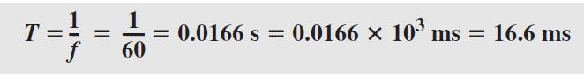
Example 3.3
The power we use at home has a frequency of 60 Hz (50 Hz in Europe). The period of this sine wave can be determined as follows:
This means that the period of the power for our lights at home is 0.0116 s, or 16.6 ms. Our eyes are not sensitive enough to distinguish these rapid changes in amplitude.
3.20
Notes:
20

Slide 21
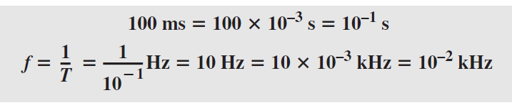
Example 3.5
The period of a signal is 100 ms. What is its frequency in kilohertz?.
Solution
First we change 100 ms to seconds, and then we calculate the frequency from the period (1 Hz = 10^{–3} kHz).
100ms
1millisecond=10⁻³s
100millisecond=100*10⁻³=10⁻¹s
F=1/t
F=1/10⁻¹=10HZ
1KH=10⁻³HZ
1HZ=1/10⁻³HZ
10HZ=10*1/10⁻³=10⁻²KHZ
3.21
Notes:
21

Slide 22
3.2.2 Phase
The term phase, or phase shift, describes the position of the waveform relative to time 0. If we think of the wave as something that can be shifted backward or forward along the time axis, phase describes the amount of that shift. It indicates the status of the first cycle.
Phase is described as the amount of wave shift
backward or forward along the time axis . It indicates
the status of first cycle
3.22
Notes:
1.#

Slide 23
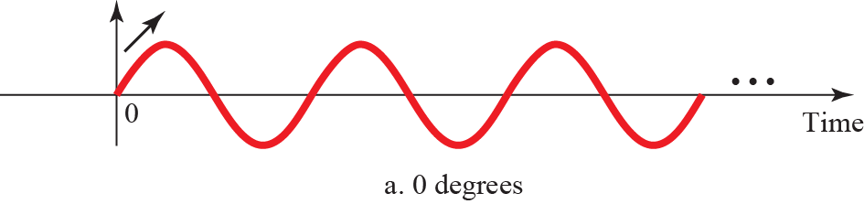
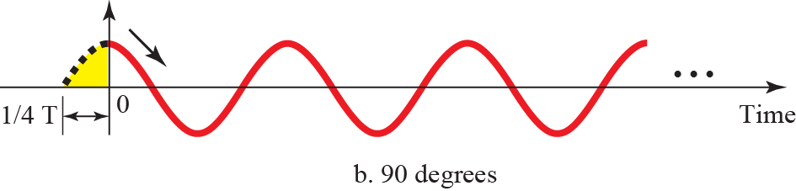
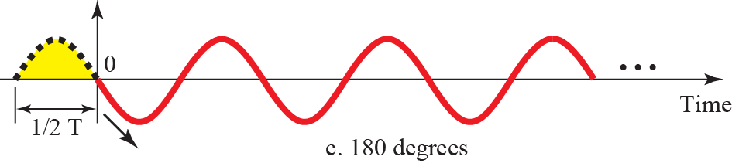
Figure 3.6: Three sine waves with different phases
3.23
Notes:
1.#

Slide 24
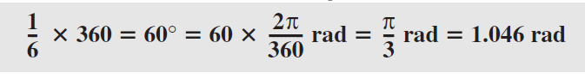
Example 3.6
A sine wave is offset 1/6 cycle with respect to time 0. What is its phase in degrees and radians?
Solution
We know that 1 complete cycle is 360°. Therefore, 1/6 cycle is
3.24
Notes:
24

Slide 25
3.2.3 Wavelength
Wavelength is another characteristic of a signal traveling through a transmission medium. Wavelength binds the period or the frequency of a simple sine wave to the propagation speed of the medium (see Figure 3.7).
A wavelength is the distance over which the wave's shape repeats
3.25
Notes:
1.#

Slide 26


Figure 3.7: Wavelength and period
3.26
Notes:
1.#

Slide 27
3.2.4 Time and Frequency Domains
A sine wave is comprehensively defined by its amplitude, frequency, and phase. We have been showing a sine wave by using what is called a time domain plot. The time-domain plot shows changes in signal amplitude with respect to time (it is an amplitude-versus-time plot). Phase is not explicitly shown on a time-domain plot.
3.27
Notes:
1.#

Slide 28
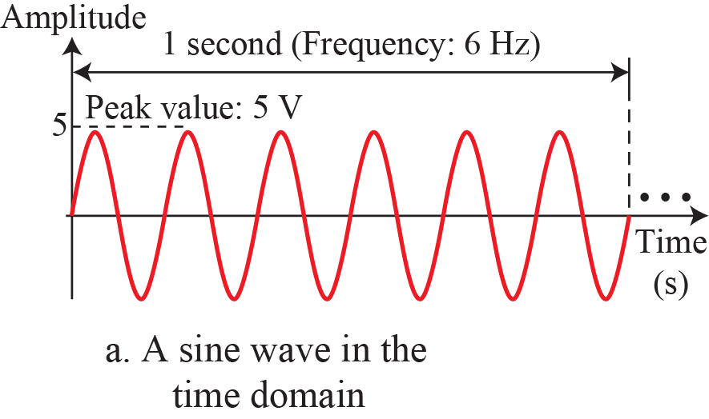
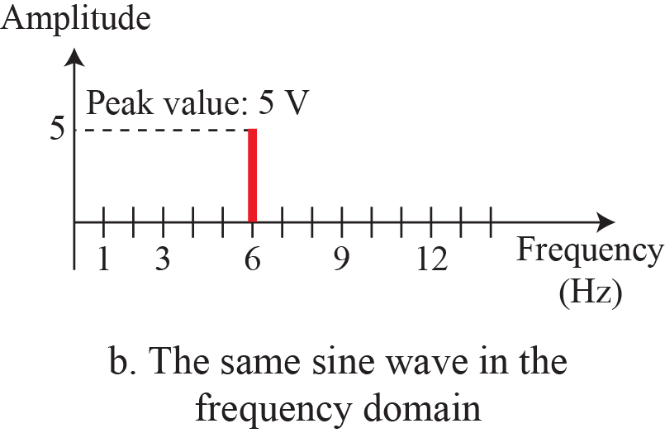
Figure 3.8: The time-domain and frequency-domain plots of a sine wave
3.28
Notes:
1.#

Slide 29
Example 3.7
The frequency domain is more compact and useful when we are dealing with more than one sine wave. For example, Figure 3.9 shows three sine waves, each with different amplitude and frequency. All can be represented by three spikes in the frequency domain.
3.29
Notes:
29

Slide 30
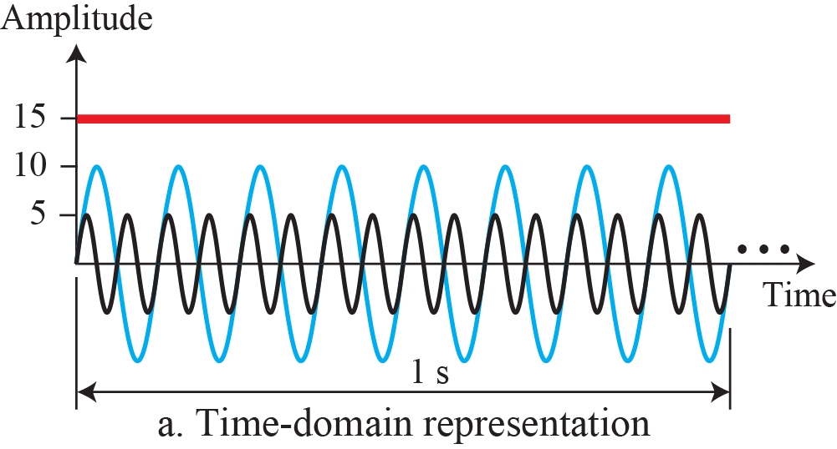
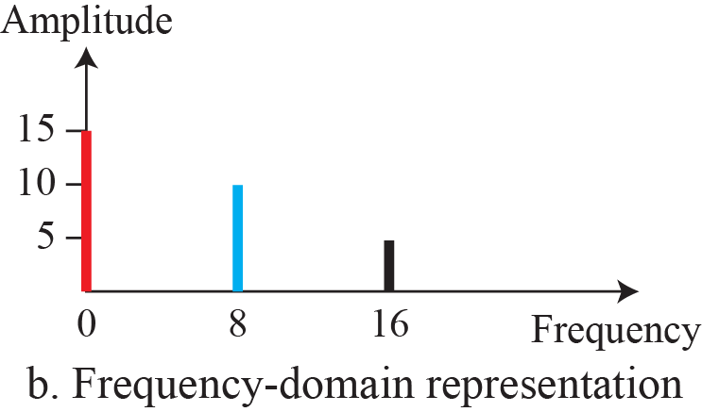
Figure 3.9: The time domain and frequency domain of three sine waves
3.30
Notes:
1.#

Slide 31
3.2.5 Composite Signals
So far, we have focused on simple sine waves. Simple sine waves have many applications in daily life. We can send a single sine wave to carry electric energy from one place to another. For example, the power company sends a single sine wave with a frequency of 60 Hz to distribute electric energy to houses and businesses. As another example, we can use a single sine wave to send an alarm to a security center when a burglar opens a door or window in the house. In the first case, the sine wave is carrying
energy; in the second, the sine wave is a signal of danger.
3.31
Notes:
1.#

Slide 32
Example 3.8
Figure 3.10 shows a periodic composite signal with frequency f. This type of signal is not typical of those found in data communications. We can consider it to be three alarm systems, each with a different frequency. The analysis of this signal can give us a good understanding of how to
decompose signals. It is very difficult to manually decompose this signal into a series of simple sine waves.
However, there are tools, both hardware and software, that can help us do the job. We are not concerned about how it is done; we are only interested in the result. Figure 3.11 shows the result of decomposing the above signal in both the time and frequency domains.
3.32
Notes:
32

Slide 33
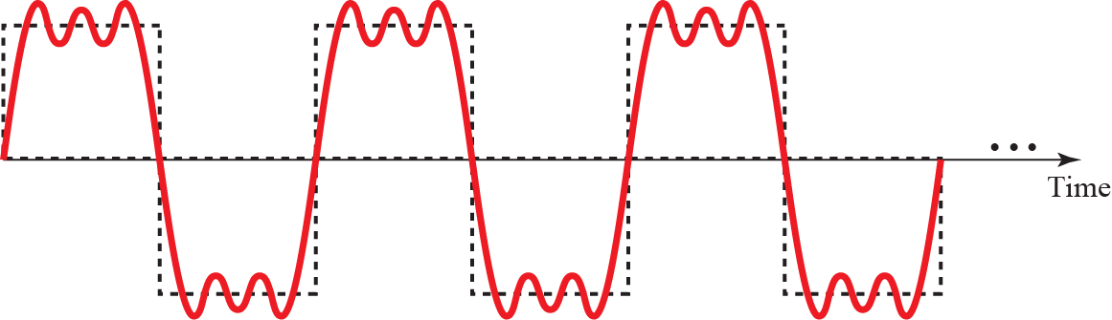
Figure 3.10: A composite periodic signal
3.33
Notes:
1.#

Slide 34
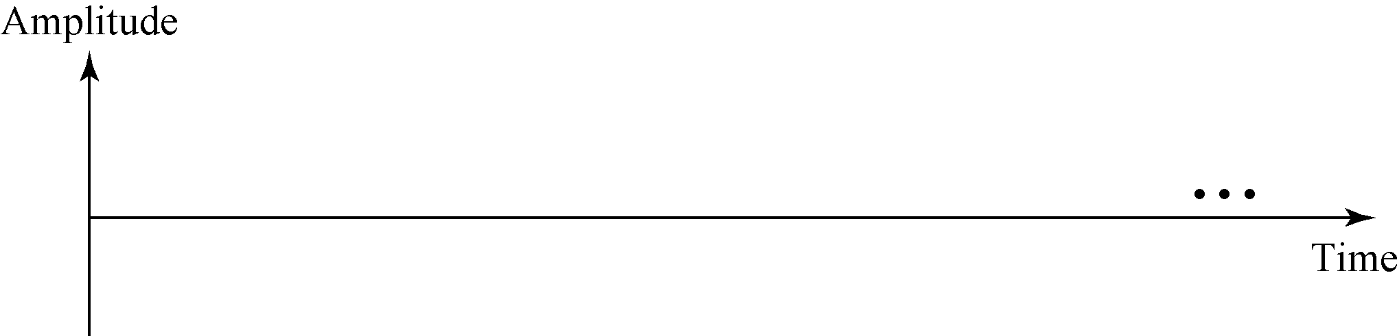

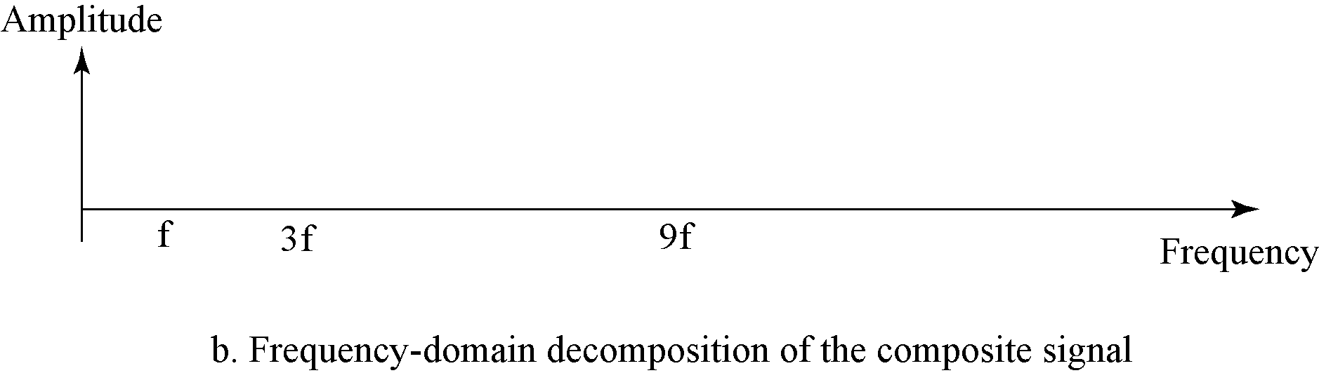


Figure 3.11: Decomposition of a composite periodic signal
3.34
Notes:
1.#

Slide 35
Example 3.9
Figure 3.12 shows a nonperiodic composite signal. It can be the signal created by a microphone or a telephone set when a word or two is pronounced. In this case, the composite signal cannot be periodic, because that implies that we are repeating the same word or words with exactly the same tone.
3.35
Notes:
35

Slide 36
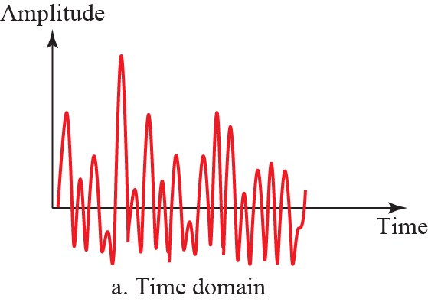
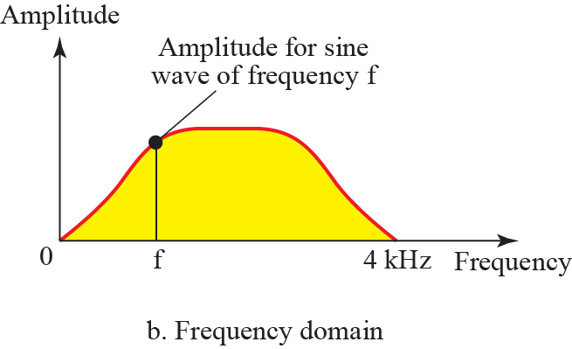
Figure 3.12: Time and frequency domain of a non-periodic signal
3.36
Notes:
1.#

Slide 37
3.2.6 Bandwidth
The range of frequencies contained in a composite signal is its bandwidth. The bandwidth is normally a difference between two numbers. For example, if a composite signal contains frequencies between 1000 and 5000, its bandwidth is 5000 − 1000, or 4000.
3.37
Notes:
1.#

Slide 38
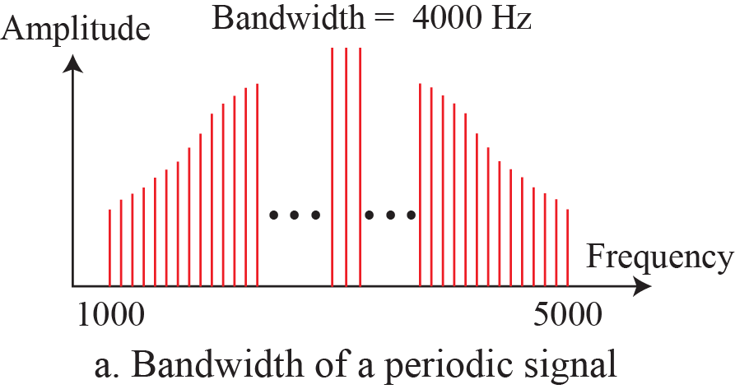
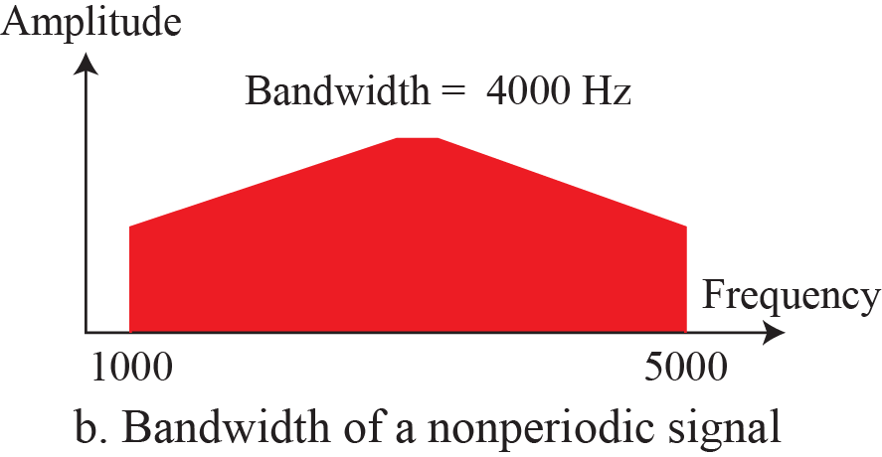
Figure 3.13: The bandwidth of periodic and nonperiodic composite
signals
3.38
Notes:
1.#

Slide 39
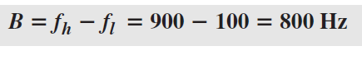
Example 3.10
If a periodic signal is decomposed into five sine waves with frequencies of 100, 300, 500, 700, and 900 Hz, what is its bandwidth? Draw the spectrum, assuming all components have a maximum amplitude of 10 V.
Solution
Let f_{h} be the highest frequency, f_{l} the lowest frequency, and B the bandwidth. Then
3.39
Notes:
39

Slide 40
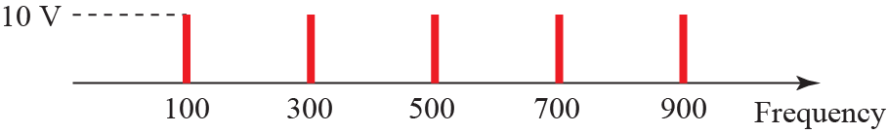
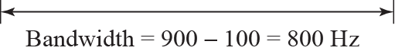
Figure 3.14: The bandwidth for example 3.10
3.40
Notes:
1.#

Slide 41
Example 3.11
A periodic signal has a bandwidth of 20 Hz. The highest frequency is 60 Hz. What is the lowest frequency? Draw the spectrum if the signal contains all frequencies of the same amplitude.
Solution
Let f_{h} be the highest frequency, f_{l} the lowest frequency, and B the bandwidth. Then
The spectrum contains all integer frequencies. We show this by a series of spikes (see Figure 3.15).
3.41
Notes:
41

Slide 42
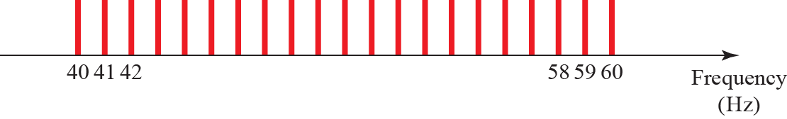
Figure 3.15: The bandwidth for example 3.11
3.42
Notes:
1.#

Slide 43
Example 3.12
A nonperiodic composite signal has a bandwidth of 200 kHz, with a middle frequency of 140 kHz and peak amplitude of 20 V. The two extreme frequencies have an amplitude of 0. Draw the frequency domain of the signal.
Solution
The lowest frequency must be at 40 kHz and the highest at 240 kHz. Figure 3.16 shows the frequency domain and the bandwidth.
Lower frequency=140-200/2=140-100=40HZ
Highest frequency=140+200/2=140+100=240HZ
3.43
Notes:
43

Slide 44
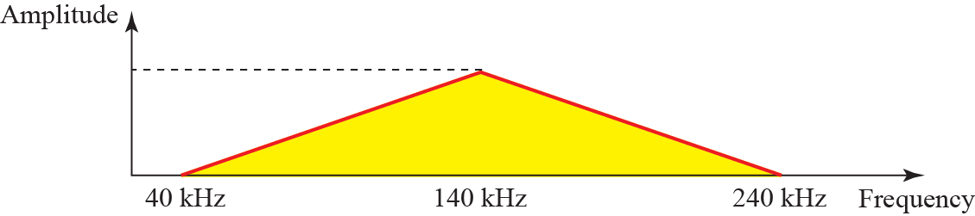
Figure 3.16: The bandwidth for example 3.12
3.44
Notes:
1.#

Slide 45
Example 3.13
An example of a nonperiodic composite signal is the signal propagated by an AM radio station. In the United States, each AM radio station is assigned a 10-kHz bandwidth. The total bandwidth dedicated to AM radio ranges from 530 to 1700 kHz. We will show the rationale behind this 10-kHz bandwidth in Chapter 5..
3.45
Notes:
45

Slide 46
Example 3.14
Another example of a nonperiodic composite signal is the signal propagated by an FM radio station. In the United States, each FM radio station is assigned a 200-kHz bandwidth. The total bandwidth dedicated to FM radio ranges from 88 to 108 MHz. We will show the rationale behind this 200-kHz bandwidth in Chapter 5.
3.46
Notes:
46

Slide 47
Example 3.15
Another example of a nonperiodic composite signal is the signal received by an old-fashioned analog black-and-white TV. A TV screen is made up of pixels (picture elements) with each pixel being either white or black. The screen is scanned 30 times per second. If we assume a resolution of 525 × 700 (525 vertical lines and 700 horizontal lines), which is a ratio of 3:4, we have 367,500 pixels per screen. If we scan the screen 30 times per second, this is 367,500 × 30 = 11,025,000 pixels per second. The worst-case scenario is alternating black and white pixels. In this case, we need to represent one color by the minimum amplitude and the other color by the maximum amplitude. We can send 2 pixels per cycle.
3.47
Notes:
47

Slide 48
Example 3.15 (continued)
Therefore, we need 11,025,000 / 2 = 5,512,500 cycles per second, or Hz. The bandwidth needed is 5.5124 MHz. This worst-case scenario has such a low probability of occurrence that the assumption is that we need only 70 percent of this bandwidth, which is 3.85 MHz. Since audio and synchronization signals are also needed, a 4-MHz bandwidth has been set aside for each black and white TV channel. An analog color TV channel has a 6-MHz bandwidth.
3.48
Notes:
48

Slide 49
3-3 DIGITAL SIGNALS
In addition to being represented by an analog signal, information can also be represented by a digital signal. For example, a 1 can be encoded as a positive voltage and a 0 as zero voltage. A digital signal can have more than two levels. In this case, we can send more than 1 bit for each level. Figure 3.17 shows two signals, one with two levels
and the other with four.
3.49
Notes:
1.#

Slide 50
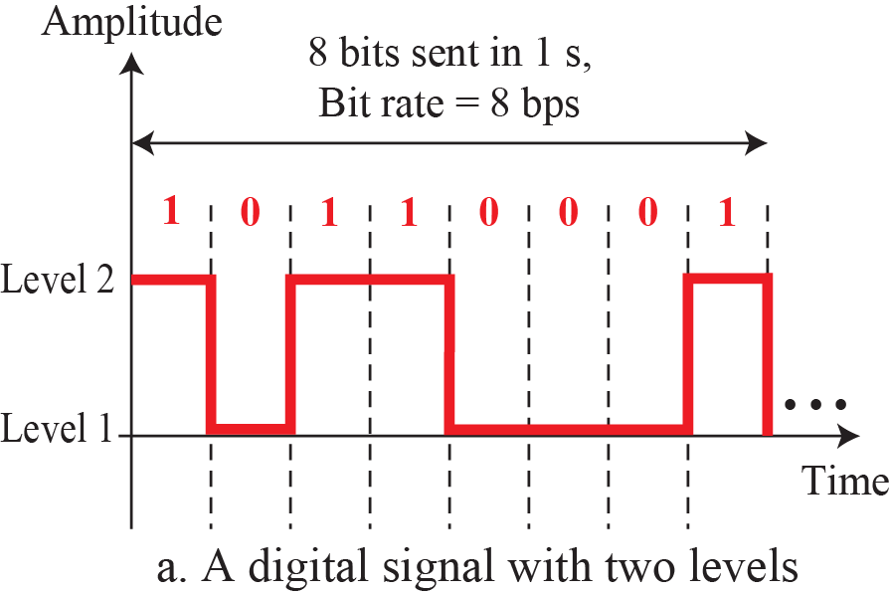
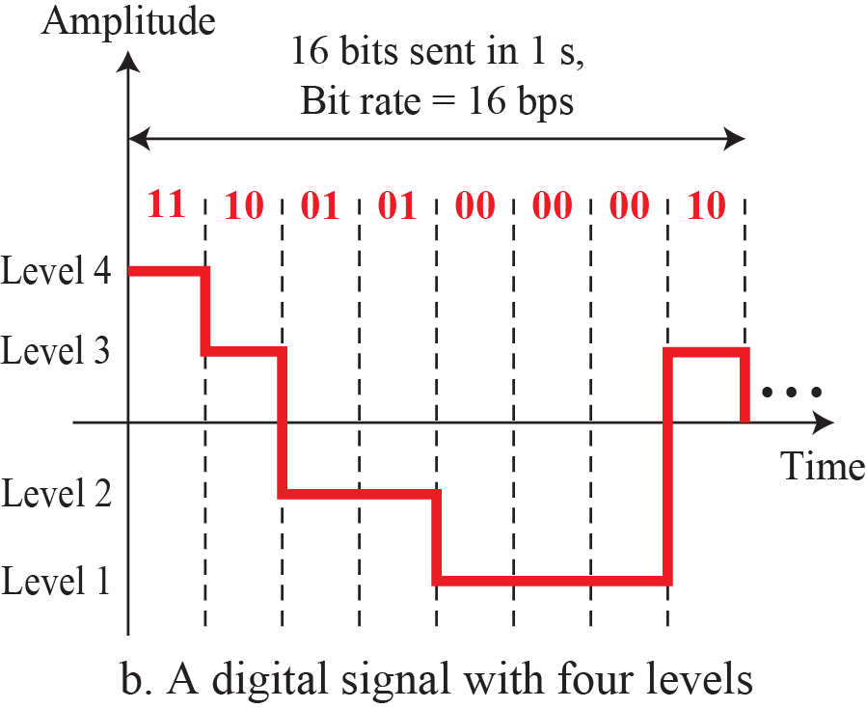
Figure 3.17: Two digital signals: one with two signal levels and the
other with four signal levels
3.50
Notes:
1.#

Slide 51
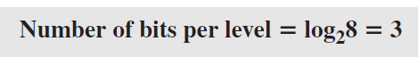
Example 3.16
A digital signal has eight levels. How many bits are needed per level? We calculate the number of bits from the following formula. Each signal level is represented by 3 bits.
3.51
Notes:
51

Slide 52
Example 3.17
A digital signal has nine levels. How many bits are needed per level? We calculate the number of bits by using the formula. Each signal level is represented by 3.17 bits. However, this answer is not realistic. The number of bits sent per level needs to be an integer as well as a power of 2. For this example, 4 bits can represent one level.
3.52
Notes:
52

Slide 53
3.3.1 Bit Rate
Most digital signals are nonperiodic, and thus period and frequency are not appropriate characteristics. Another term—bit rate (instead of frequency)—is used to describe digital signals. The bit rate is the number of bits sent in 1s, expressed in bits per second (bps). Figure 3.17 shows the bit rate for two signals.
3.53
Notes:
1.#

Slide 54

Example 3.18
Assume we need to download text documents at the rate of 100 pages per second. What is the required bit rate of the channel?
Solution
From Table 3.1 we find the equivalents of 1 ms (1 ms is 10–3 s) and 1 s (1 s is 106 μs). We make the following substitutions:
100 pages/second
24 lines/pages
80 words/line
8 bit/character
3.54
Notes:
54

Slide 55

Example 3.19
A digitized voice channel, as we will see in Chapter 4, is made by digitizing a 4-kHz bandwidth analog voice signal. We need to sample the signal at twice the highest frequency (two samples per hertz). We assume that each sample requires 8 bits. What is the required bit rate?
Solution
A page is an average of 24 lines with 80 characters in each line. If we assume that one character requires 8 bits, the bit rate is
3.55
Notes:
55

Slide 56
Example 3.20
What is the bit rate for high-definition TV (HDTV)?
Solution
HDTV uses digital signals to broadcast high quality video signals. The HDTV screen is normally a ratio of 16 : 9 (in contrast to 4 : 3 for regular TV), which means the screen is wider. There are 1920 by 1080 pixels per screen, and the screen is renewed 30 times per second. Twenty-four bits represents one color pixel. We can calculate the bit rate as
The TV stations reduce this rate to 20 to 40 Mbps through compression.
3.56
Notes:
56

Slide 57
3.3.2 Bit Length
We discussed the concept of the wavelength for an analog signal: the distance one cycle occupies on the transmission medium. We can define something similar for a digital signal: the bit length. The bit length is the distance one bit occupies on the transmission medium.
Bit length=propagation speed * bit duration
3.57
Notes:
1.#

Slide 58
3.3.3 Digital As Composite Analog
Based on Fourier analysis (See Appendix E), a digital signal is a composite analog signal. The bandwidth is infinite, as you may have guessed. We can intuitively come up with this concept when we consider a digital signal. A digital signal, in the time domain, comprises connected vertical and horizontal line segments. A vertical line in the time domain means a frequency of infinity: a horizontal line in the time domain means a frequency of zero. Going from a frequency of zero to a frequency of infinity implies all frequencies in between are part of the domain.
3.58
Notes:
1.#

Slide 59
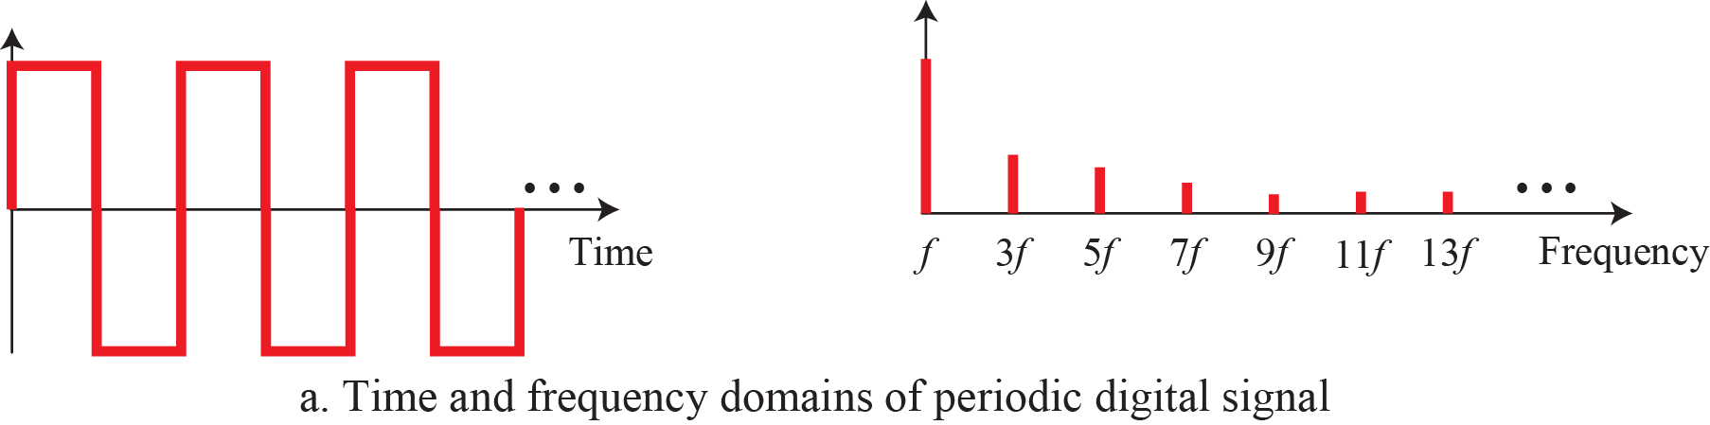
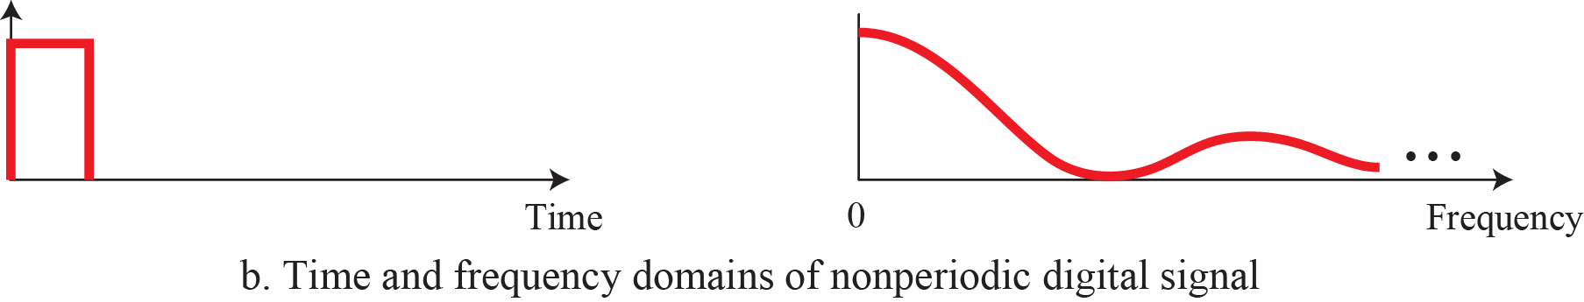
Figure 3.18: The time and frequency domains of periodic and
nonperiodic digital signals
3.59
Notes:
1.#

Slide 60
3.3.4 Transmission of Digital Signals
Based on Fourier analysis (See Appendix E), a digital signal is a composite analog signal. The bandwidth is infinite, as you may have guessed. We can intuitively come up with this concept when we consider a digital signal. A digital signal, in the time domain, comprises connected vertical and horizontal line segments. A vertical line in the time domain means a frequency of infinity: a horizontal line in the time domain means a frequency of zero. Going from a frequency of zero to a frequency of infinity implies all frequencies in between are
part of the domain.
3.60
Notes:
1.#

Slide 61
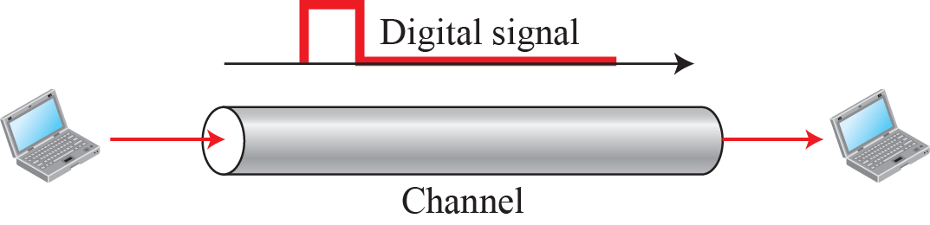
Figure 3.19: Baseband transmission
3.61
Notes:
1.#

Slide 62
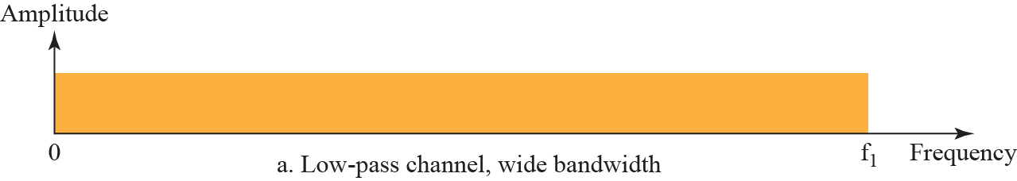
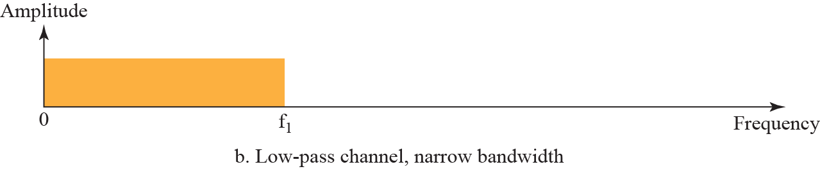
Figure 3.20: Bandwidth of two low-pass channels
3.62
Notes:
1.#

Slide 63
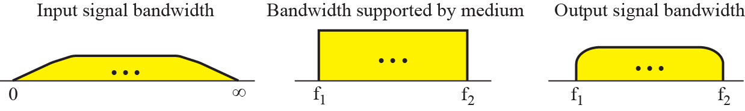
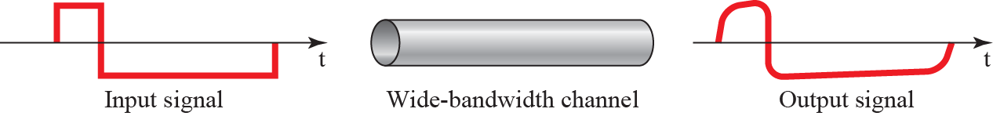
Figure 3.21: Baseband transmission using a dedicated medium
3.63
Notes:
1.#

Slide 64
Example 3.21
An example of a dedicated channel where the entire bandwidth of the medium is used as one single channel is a LAN. Almost every wired LAN today uses a dedicated channel for two stations communicating with each other. In a bus topology LAN with multipoint connections, only two stations can communicate with each other at each moment in time (timesharing); the other stations need to refrain from sending data. In a star topology LAN, the entire channel between each station and the hub is used for communication between these two entities. We study LANs in Chapter 13.
3.64
Notes:
64

Slide 65
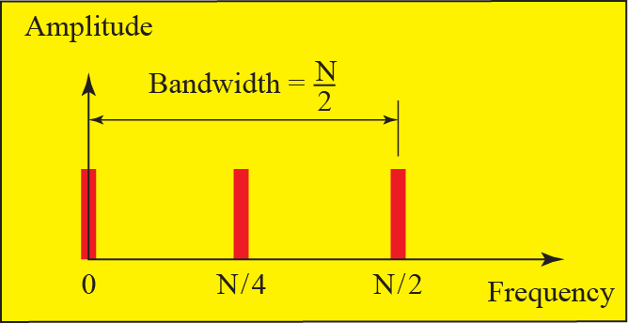
Figure 3.22: Rough approximation of a digital signal (part 1)
N=highest frequency
3.65
Notes:
1.#

Slide 66
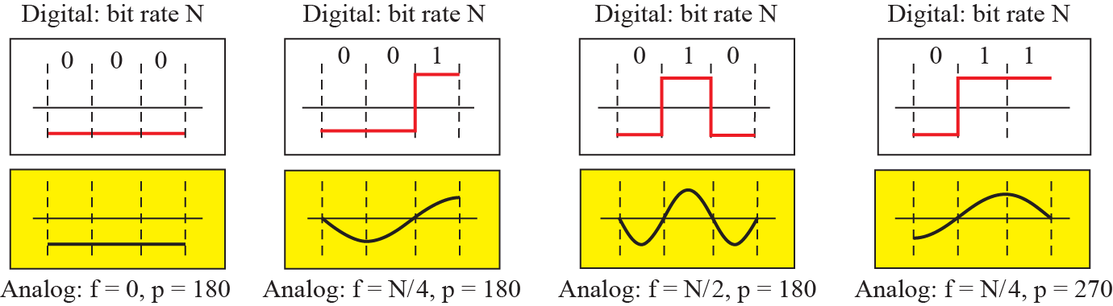
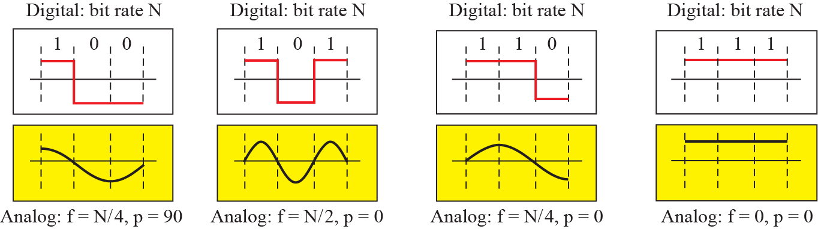
Figure 3.22: Rough approximation of a digital signal (part 2)
3.66
Notes:
1.#

Slide 67
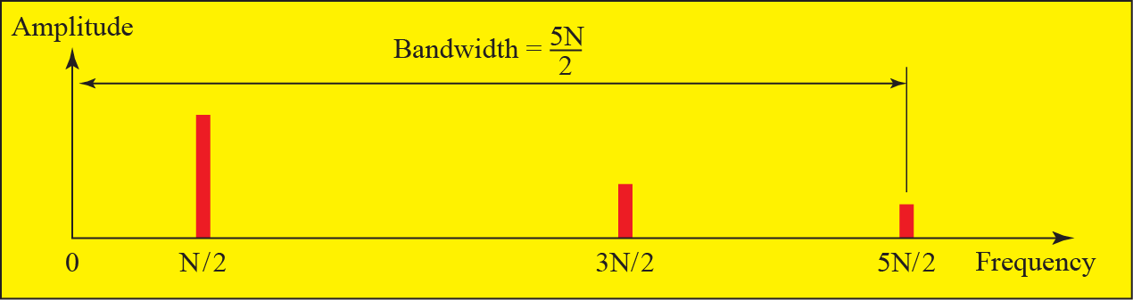
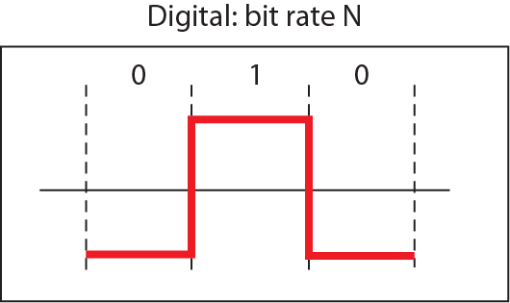
Figure 3.23: Simulating a digital signal with first three harmonics (part I)
3.67
Notes:
1.#

Slide 68
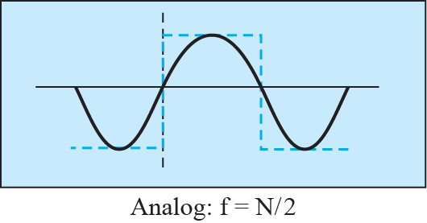
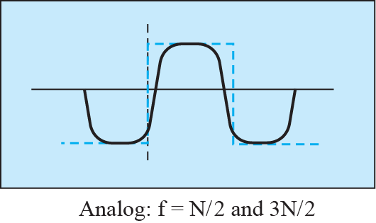

Figure 3.23: Simulating a digital signal with first three harmonics (part II)
3.68
Notes:
1.#

Slide 69

Table 3.2: Bandwidth requirements
3.69
Notes:
69

Slide 70
Example 3.22
What is the required bandwidth of a low-pass channel if we need to send 1 Mbps by using baseband transmission?
Solution
The answer depends on the accuracy desired.
a. The minimum bandwidth, a rough approximation, is B bit rate /2, or 500 kHz. We need a low-pass channel with frequencies between 0 and 500 kHz.
b. A better result can be achieved by using the first and the third harmonics with the required bandwidth B = 3 × 500 kHz = 1.5 MHz.
c. A still better result can be achieved by using the first, third, and fifth harmonics with B = 5 × 500 kHz = 2.5 MHz.
3.70
Notes:
70

Slide 71
Example 3.23
We have a low-pass channel with bandwidth 100 kHz. What is the maximum bit rate of this channel?.
Solution
The maximum bit rate can be achieved if we use the first harmonic. The bit rate is 2 times the available bandwidth, or 200 kbps.
3.71
Notes:
71

Slide 72

Figure 3.24: Bandwidth of a band-pass channel
3.72
Notes:
1.#

Slide 73







Figure 3.25: Modulation of a digital signal for transmission on band-pass channel
3.73
Notes:
1.#

Slide 74
Example 3.24
An example of broadband transmission using modulation is the sending of computer data through a telephone subscriber line, the line connecting a resident to the central telephone office. These lines, installed many years ago, are designed to carry voice (analog signal) with a limited bandwidth. Although this channel can be used as a low-pass channel, it is normally considered a bandpass channel. One reason is that the bandwidth is so narrow (4 kHz) that if we treat the channel as low-pass and use it for baseband transmission, the maximum bit rate can be only 8 kbps. The solution is to consider the channel a bandpass channel, convert the digital signal from the computer to an analog signal, and send the analog signal.
3.74
Notes:
74

Slide 75
Example 3.25
A second example is the digital cellular telephone. For better reception, digital cellular phones digitize analog voice. Although the bandwidth allocated to a company providing digital cellular phone service is very wide, we still cannot send the digitized signal without conversion. The reason is that we have only a band-pass channel available between caller and callee. For example, if the available bandwidth is W and we allow 1000 couples to talk simultaneously, this means the available channel is W/1000, just part of the entire bandwidth. We need to convert the digitized voice to a composite analog signal before transmission.
3.75
Notes:
75

Slide 76
3-4 TRANSMISSION IMPAIRMENT
Signals travel through transmission media, which are not perfect. The imperfection causes signal impairment. This means that the signal at the beginning of the medium is not the same as the signal at the end of the medium. What is sent is not what is received. Three causes of impairment are attenuation, distortion, and noise (see Figure 3.26).
3.76
Notes:
1.#

Slide 77

Figure 3.26: Causes of impairment
3.77
Notes:
1.#

Slide 78
3.4.1 Attenuation
Attenuation means a loss of energy. When a signal, simple or composite, travels through a medium, it loses some of its energy in overcoming the resistance of the medium. That is why a wire carrying electric signals gets warm, if not hot, after a while. Some of the electrical energy in the signal is converted to heat. To compensate for this loss, amplifiers are used to amplify the signal. Figure 3.27 shows the effect of attenuation and amplification..
10 log₁₀ p₂/p1
3.78
Notes:
1.#

Slide 79




Figure 3.27: Attenuation and amplification
3.79
Notes:
1.#

Slide 80
Example 3.26
Suppose a signal travels through a transmission medium and its power is reduced to one half. This means that P2 = 0.5 P1. In this case, the attenuation (loss of power) can be calculated as
A loss of 3 dB (−3 dB) is equivalent to losing one-half the power.
3.80
Notes:
80

Slide 81

Example 3.27
A signal travels through an amplifier, and its power is increased 10 times. This means that P₂ = 10P₁. In this case, the amplification (gain of power) can be calculated as
3.81
Notes:
81

Slide 82

Figure 3.28: Decibels for Example 3.28
3.82
Notes:
1.#

Slide 83

Example 3.28
One reason that engineers use the decibel to measure the changes in the strength of a signal is that decibel numbers can be added (or subtracted) when we are measuring several points (cascading) instead of just two. In Figure 3.28 a signal travels from point 1 to point 4. The signal is attenuated by the time it reaches point 2. Between points 2 and 3, the signal is amplified. Again, between points 3 and 4, the signal is attenuated. We can find the resultant decibel value for the signal just by adding the decibel measurements between each set of points. In this case, the decibel value can be calculated as
3.83
Notes:
83

Slide 84
Example 3.29
Sometimes the decibel is used to measure signal power in milliwatts. In this case, it is referred to as dB_{m} and is calculated as dB_{m} = 10 log10 Pm, where Pm is the power in milliwatts. Calculate the power of a signal if its dB_{m} = −30.
Solution
We can calculate the power in the signal as
3.84
Notes:
84

Slide 85

Example 3.30
The loss in a cable is usually defined in decibels per kilometer (dB/km). If the signal at the beginning of a cable with −0.3 dB/km has a power of 2 mW, what is the power of the signal at 5 km?
Solution
The loss in the cable in decibels is 5 × (−0.3) = −1.5 dB. We can calculate the power as
3.85
Notes:
85

Slide 86
3.4.2 Distortion
Distortion means that the signal changes its form or shape. Distortion can occur in a composite signal made of different frequencies. Each signal component has its own propagation speed (see the next section) through a medium and, therefore, its own delay in arriving at the final destination. Differences in delay may create a difference in phase if the delay is not exactly the same as the period duration.
3.86
Notes:
1.#

Slide 87


Figure 3.29: Distortion
3.87
Notes:
1.#

Slide 88
3.4.3 Noise
Noise is another cause of impairment. Several types of noise, such as thermal noise, induced noise, crosstalk, and impulse noise, may corrupt the signal. Thermal noise is the random motion of electrons in a wire, which creates an extra signal not originally sent by the transmitter. Induced noise comes from sources such as motors. Crosstalk is the effect of one wire on the other.
3.88
Notes:
1.#

Slide 89



Figure 3.30: Noise
3.89
Notes:
1.#

Slide 90


Figure 3.31: Two cases of SNR: a high SNR and a low SNR
3.90
Notes:
1.#

Slide 91
Example 3.31
The power of a signal is 10 mW and the power of the noise is 1 μW; what are the values of SNR and SNR_{dB}?
Noise=1uw=0.001mw
SNR=Signal power/noise power
Solution
The values of SNR and SNR_{dB} can be calculated as follows:
dB
3.91
Notes:
91

Slide 92
Example 3.32
The values of SNR and SNR_{dB} for a noiseless channel are
Solution
The values of SNR and SNRdB for a noiseless channel are
We can never achieve this ratio in real life; it is an ideal.
3.92
Notes:
92

Slide 93
3-5 DATA RATE LIMITS
A very important consideration in data communications is how fast we can send data, in bits per second, over a channel. Two theoretical formulas were developed to calculate the data rate: one by Nyquist for a noiseless channel, another by Shannon for a noisy channel.
3.93
Notes:
1.#

Slide 94
3.5.1 Noiseless Channel: Nyquist Rate
For a noiseless channel, the Nyquist bit rate formula defines the theoretical maximum bit rate.
BitRate=2* bandwidth * log₂L
L=signal level
3.94
Notes:
1.#

Slide 95
Example 3.33
Does the Nyquist theorem bit rate agree with the intuitive bit rate described in baseband transmission?
Solution
They match when we have only two levels. We said, in baseband transmission, the bit rate is 2 times the bandwidth if we use only the first harmonic in the worst case. However, the Nyquist formula is more general than what we derived intuitively; it can be applied to baseband transmission and modulation. Also, it can be applied when we have two or more levels of signals.
3.95
Notes:
95

Slide 96

Example 3.34
Consider a noiseless channel with a bandwidth of 3000 Hz transmitting a signal with two signal levels. The maximum bit rate can be calculated as
3.96
Notes:
96

Slide 97

Example 3.35
Consider the same noiseless channel transmitting a signal with four signal levels (for each level, we send 2 bits). The maximum bit rate can be calculated as
3.97
Notes:
97

Slide 98
Example 3.36
We need to send 265 kbps over a noiseless channel with a bandwidth of 20 kHz. How many signal levels do we need?
Given result in bps so remember to convert all units in bps
Solution
We can use the Nyquist formula as shown:
Since this result is not a power of 2, we need to either increase the number of levels or reduce the bit rate. If we have 128 levels, the bit rate is 280 kbps. If we have 64 levels, the bit rate is 240 kbps.
3.98
Notes:
98

Slide 99
3.5.2 Noisy Channel: Shannon Capacity
In reality, we cannot have a noiseless channel; the channel is always noisy. In 1944, Claude Shannon introduced a formula, called the Shannon capacity, to determine the theoretical highest data rate for a noisy channel:
Capacity=bandwidth * log₂(1+SNR)
3.99
Notes:
1.#

Slide 100
Example 3.37
Consider an extremely noisy channel in which the value of the signal-to-noise ratio is almost zero. In other words, the noise is so strong that the signal is faint. For this channel the capacity C is calculated as
This means that the capacity of this channel is zero regardless of the bandwidth. In other
words, we cannot receive any data through this channel.
3.100
Notes:
100

Slide 101
Example 3.38
We can calculate the theoretical highest bit rate of a regular telephone line. A telephone line normally has a bandwidth of 3000 Hz (300 to 3300 Hz) assigned for data communications. The signal-to-noise ratio is usually 3162. For this channel the capacity is calculated as
This means that the highest bit rate for a telephone line is 34.860 kbps. If we want to send data faster than this, we can either increase the bandwidth of the line or improve the signal-to-noise ratio.
3.101
Notes:
101

Slide 102

Example 3.39
The signal-to-noise ratio is often given in decibels. Assume that SNR_{dB} = 36 and the channel bandwidth is 2 MHz. The theoretical channel capacity can be calculated as
3.102
Notes:
102

Slide 103

Example 3.40
When the SNR is very high, we can assume that SNR + 1 is almost the same as SNR. In these cases, the theoretical channel capacity can be simplified to C=B*SNR_{dB}. For example, we can calculate the theoretical capacity of the previous example as
3.103
Notes:
103

Slide 104
3.5.3 Using Both Limits
In practice, we need to use both methods to find the limits and signal levels. Let us show this with an example.
3.104
Notes:
1.#

Slide 105

Example 3.41
We have a channel with a 1-MHz bandwidth. The SNR for this channel is 63. What are the appropriate bit rate and signal level?
Solution
First, we use the Shannon formula to find the upper limit.
The Shannon formula gives us 6 Mbps, the upper limit. For better performance we choose something lower, 4 Mbps. Then we use the Nyquist formula to find the number of signal levels.
3.105
Notes:
105

Slide 106
3-6 PERFORMANCE
Up to now, we have discussed the tools of transmitting data (signals) over a network and how the data behave. One important issue in networking is the performance of the network—how good is it? In this section, we introduce terms that we need for future chapters.
3.106
Notes:
1.#

Slide 107
3.6.1 Bandwidth
One characteristic that measures network performance is bandwidth. However, the term can be used in two different contexts with two different measuring values: bandwidth in hertz and bandwidth in bits per second..
3.107
Notes:
1.#

Slide 108
Example 3.42
The bandwidth of a subscriber line is 4 kHz for voice or data. The bandwidth of this line for data transmission
can be up to 56,000 bps using a sophisticated modem to change the digital signal to analog.
3.108
Notes:
108

Slide 109
Example 3.43
If the telephone company improves the quality of the line and increases the bandwidth to 8 kHz, we can send 112,000 bps by using the same technology as mentioned in Example 3.42.
3.109
Notes:
109

Slide 110
3.6.2 Throughput
The throughput is a measure of how fast we can actually send data through a network. Although, at first glance, bandwidth in bits per second and throughput seem the same, they are different. A link may have a bandwidth of B bps, but we can only send T bps through this link with T always less than B.
Total bits per min=Avg frame per min * Avg bit per frame
Throughput=Total bit per min/Time taken to transmit these bits
3.110
Notes:
1.#

Slide 111
3.6.3 Throughput
The latency or delay defines how long it takes for an entire message to completely arrive at the destination from the time the first bit is sent out from the source. We can say that latency is made of four components: propagation time, transmission time, queuing time and processing delay.
Latency=propagation time + transmission time + queuing time + processing delay
3.111
Notes:
1.#

Slide 112
Example 3.44
A network with bandwidth of 10 Mbps can pass only an average of 12,000 frames per minute with each frame carrying an average of 10,000 bits. What is the throughput of this network?
Solution
We can calculate the throughput as
=2000000bits/second
The throughput is almost one-fifth of the bandwidth in this case.
3.112
Notes:
112

Slide 113
Example 3.45
What is the propagation time if the distance between the two points is 12,000 km? Assume the propagation speed to be 2.4 × 108 m/s in cable.
Propagation time=distance /speed
12000km=12000*10000=120000000m
Solution
We can calculate the propagation time as
The example shows that a bit can go over the Atlantic Ocean in only 50 ms if there is a direct cable between the source and the destination.
3.113
Notes:
113

Slide 114

Example 3.46
What are the propagation time and the transmission time for a 2.5-KB (kilobyte) message if the bandwidth of the network is 1 Gbps? Assume that the distance between the sender and the receiver is 12,000 km and that light travels at 2.4 × 108 m/s.
Transmission Time=Message Size/Bandwidth
Solution
We can calculate the propagation and transmission time as
1MBPS=10⁶ and 1GBPS=10⁹
Note that in this case, because the message is short and the bandwidth is high, the dominant factor is the propagation time, not the transmission time.
3.114
Notes:
114

Slide 115

Example 3.47
What are the propagation time and the transmission time for a 5-MB (megabyte) message (an image) if the bandwidth of the network is 1 Mbps? Assume that the distance between the sender and the receiver is 12,000 km and that light travels at 2.4 × 108 m/s.
Solution
We can calculate the propagation and transmission times as
We can calculate the propagation and transmission times as
3.115
Notes:
115

Slide 116
3.6.4 Bandwidth-Delay Product
Bandwidth and delay are two performance metrics of a link. However, as we will see in this chapter and future chapters, what is very important in data communications is the product of the two, the bandwidth-delay product. Let us elaborate on this issue, using two hypothetical cases as examples.
3.116
Notes:
1.#

Slide 117

Figure 3.32: Filling the links with bits for Case 1
3.117
Notes:
1.#

Slide 118

Figure 3.33: Filling the pipe with bits for Case 2
3.118
Notes:
1.#

Slide 119
Example 3.48
We can think about the link between two points as a pipe. The cross section of the pipe represents the bandwidth, and the length of the pipe represents the delay. We can say the volume of the pipe defines the bandwidth-delay product, as shown in Figure 3.34.
3.119
Notes:
119

Slide 120



Figure 3.34: Concept of bandwidth-delay product
Volume=bandwidth * delay
3.120
Notes:
1.#

Slide 121
3.6.5 Jitter
Another performance issue that is related to delay is jitter. We can roughly say that jitter is a problem if different packets of data encounter different delays and the application using the data at the receiver site is time-sensitive (audio and video data, for example). If the delay for the first packet is 20 ms, for the second is 45 ms, and for the third is 40 ms, then the real-time application that uses the packets endures jitter. We discuss jitter in greater detail in Chapter 28.
3.121
Notes:
1.#

